Slide 1
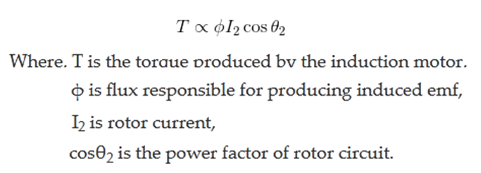
Torque Equation of Three Phase Induction Motor
The torque produced by three phase induction motor depends upon the following three factors:
Firstly the magnitude of rotor current,
secondly the flux which interact with the rotor of three phase induction motor and is responsible for producing emf in the rotor part of induction motor,
lastly the power factor of rotor of the three phase induction motor.
Combining all these factors, we get the equation of torque as-

Slide 2
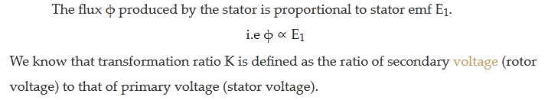
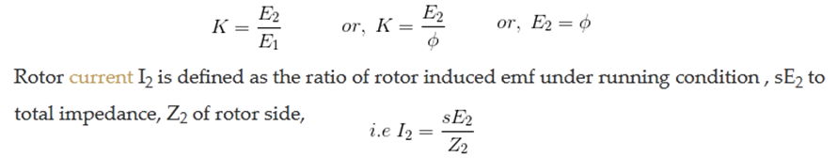
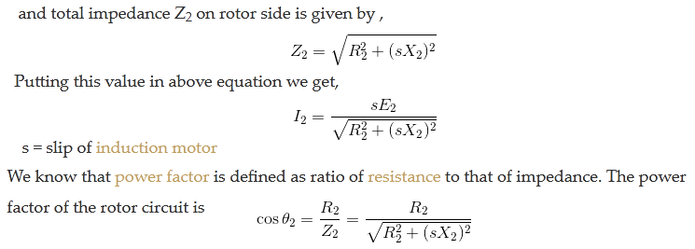

Slide 3
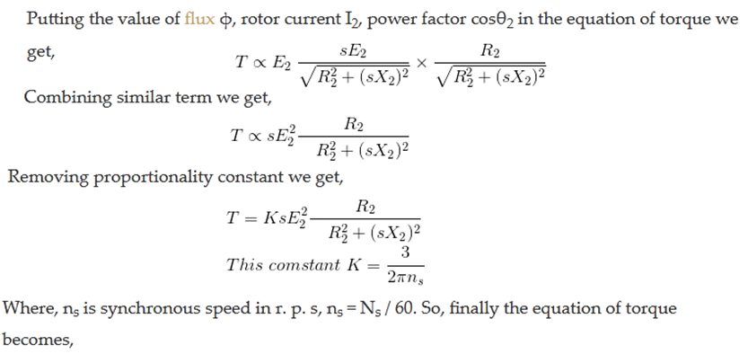

Slide 4
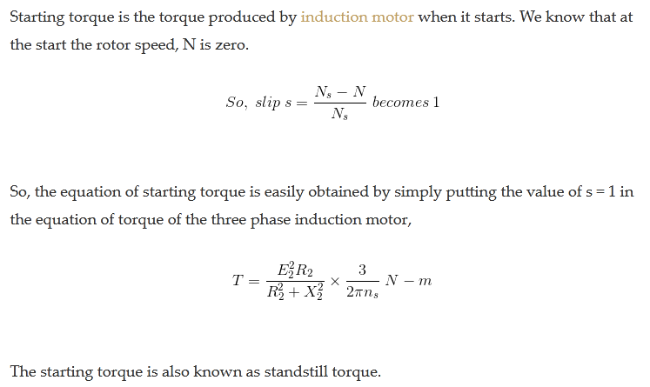
Equation of Starting Torque of 3Ø Induction Motor

Slide 5

Maximum Torque Condition for 3Ø Induction Motor
In the equation of torque,
The rotor resistance, rotor inductive reactance and synchronous speed of induction motor remain constant.
The supply voltage to the three phase induction motor is usually rated and remains constant, so the stator emf also remains the constant.
We define the transformation ratio as the ratio of rotor emf to that of stator emf.
So if stator emf remains constant, then rotor emf also remains constant.
If we want to find the maximum value of some quantity, then we have to differentiate that quantity concerning some variable parameter and then put it equal to zero.

Slide 6
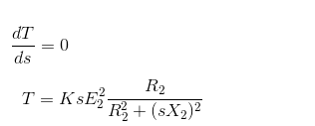

In this case, we have to find the condition for maximum torque, so we have to differentiate torque concerning some variable quantity which is the slip, s in this case as all other parameters in the equation of torque remains constant.
So, for torque to be maximum
Now differentiate the above equation by using division rule of differentiation. On differentiating and after putting the terms equal to zero we get,
So, when slip s = R₂ / X₂, the torque will be maximum and this slip is called maximum slip Sm and it is defined as the ratio of rotor resistance to that of rotor reactance.
NOTE: At starting S = 1, so the maximum starting torque occur when rotor resistance is equal to rotor reactance.

Slide 7
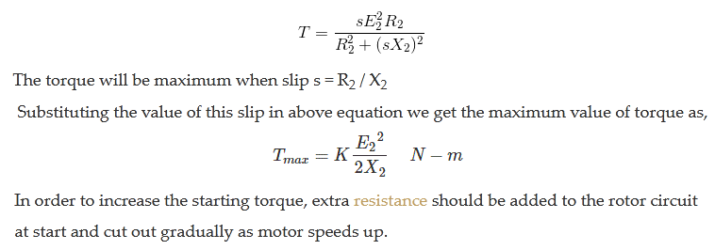
Equation of Maximum Torque is

Slide 8
Conclusion:
From the above equation it is concluded that
The maximum torque is directly proportional to square of rotor induced emf at the standstill.
The maximum torque is inversely proportional to rotor reactance.
The maximum torque is independent of rotor resistance.
The slip at which maximum torque occur depends upon rotor resistance, R₂.
So, by varying the rotor resistance, maximum torque can be obtained at any required slip.

